Slide 1
Title: Student Management System
Subtitle: By: Resham Shah, Aaditya Kumar, Devyani Khadka, Aaradhya Bhattarai

Slide 2
Project Overview
Content:
This project is a console-based Student Management System developed in Python.
It includes features for both admin and student users, using login authentication from text files.
Technologies used:
- Python
- Pandas
- NumPy
- Matplotlib
Text files are used to store user credentials, grades, and ECA (Extra-Curricular Activity) records.

Slide 3
Code Logic Flow
Content:
1. The system begins with a login prompt asking if you are a student or admin.
2. Credentials are validated from:
- 'password.txt' for students
- 'adminpassword.txt' for admins
3. Admin users can:
- Manage student records
- View and modify grades and ECA data
4. Student users can:
- View personal information
- Check grades and ECA status
5. Uses Pandas for data reading/manipulation and Matplotlib for visualizing results.

Slide 4
File Usage
Content:
- password.txt → Stores student login credentials
- adminpassword.txt → Stores admin login credentials
- users.txt → Student details (name, ID, etc.)
- grades.txt → Subject-wise grades for students
- eca.txt → Extra-curricular activity details
Each file is read dynamically when a user logs in or accesses data.

Slide 5
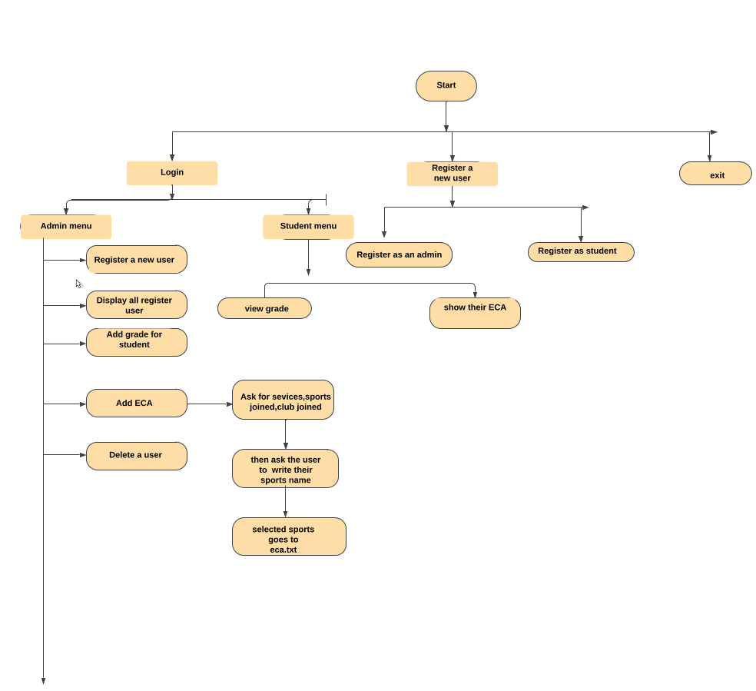
Flowchart
Content:
Refer to the 'Flowchart.pdf' file for a visual representation of the program flow.

Slide 6
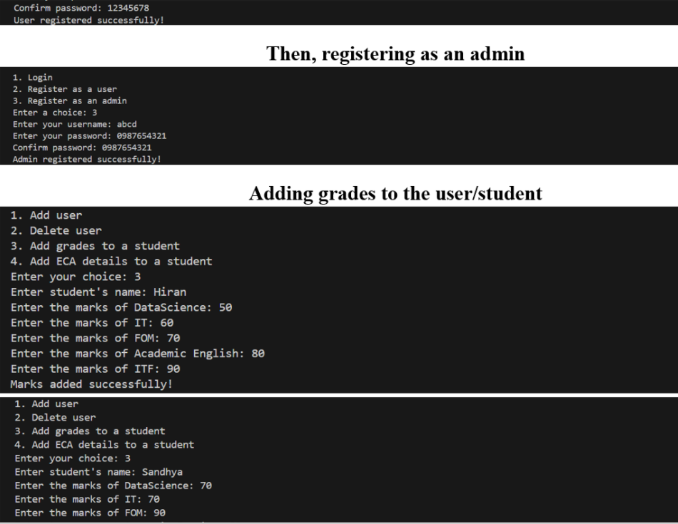
Inputs & Outputs
Content:
The system runs in a terminal/command-line environment.
Example I/O:
- Login prompts
- Student information display
- Grade and ECA summary

Slide 7
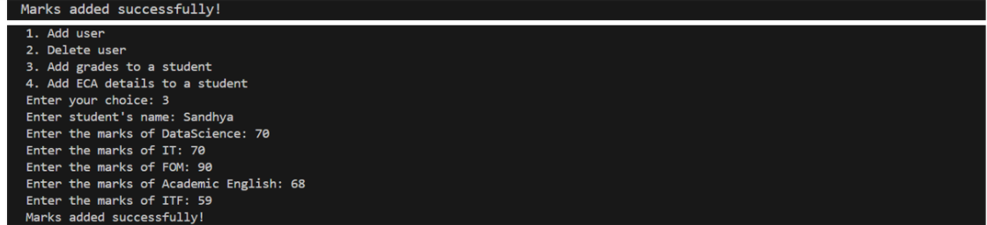

Slide 8
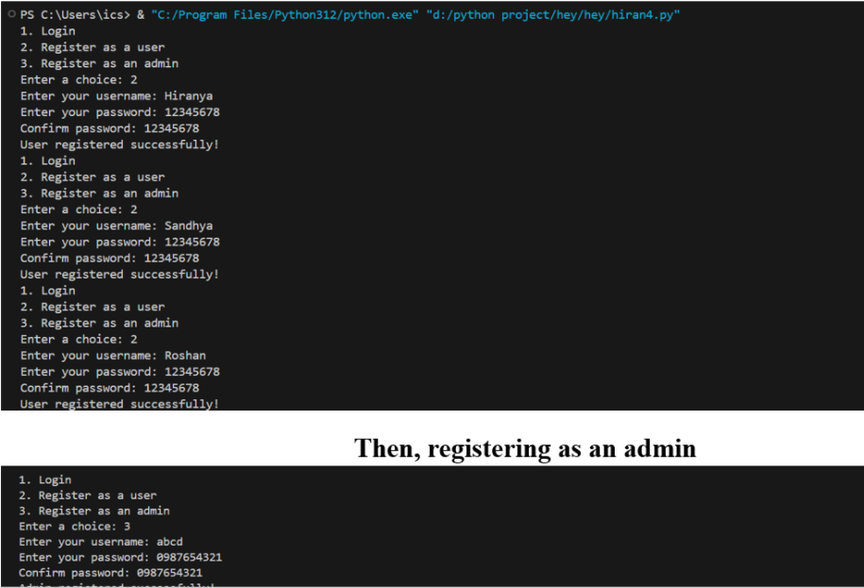
aaa

Slide 9
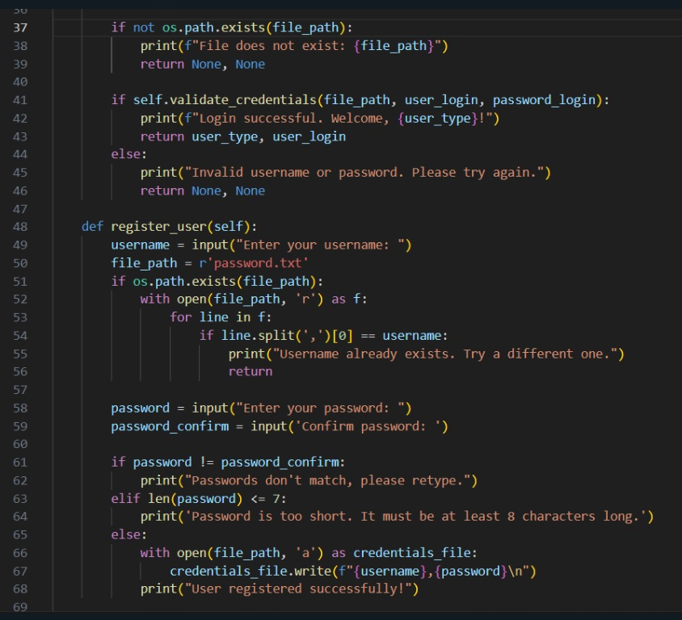

Slide 10
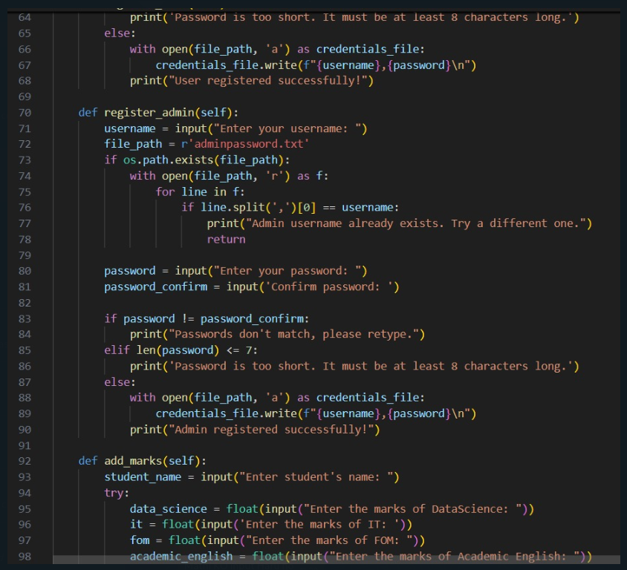

Slide 11
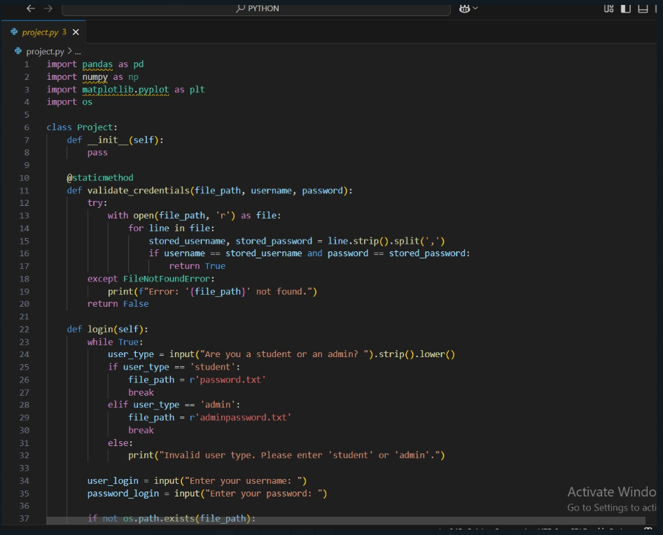

Slide 12
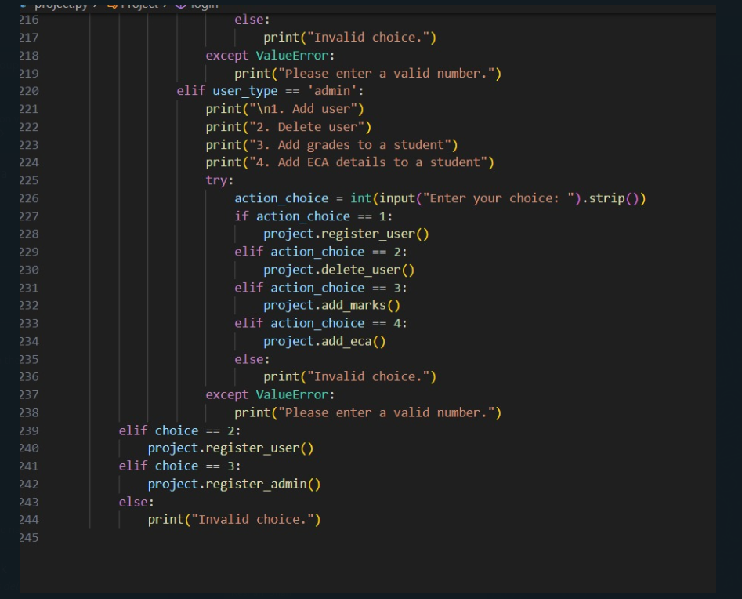

Slide 13
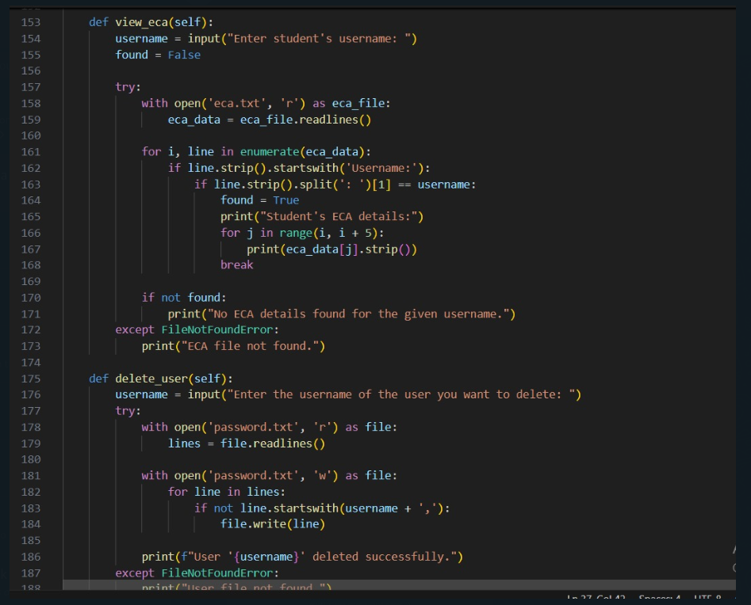

Slide 14
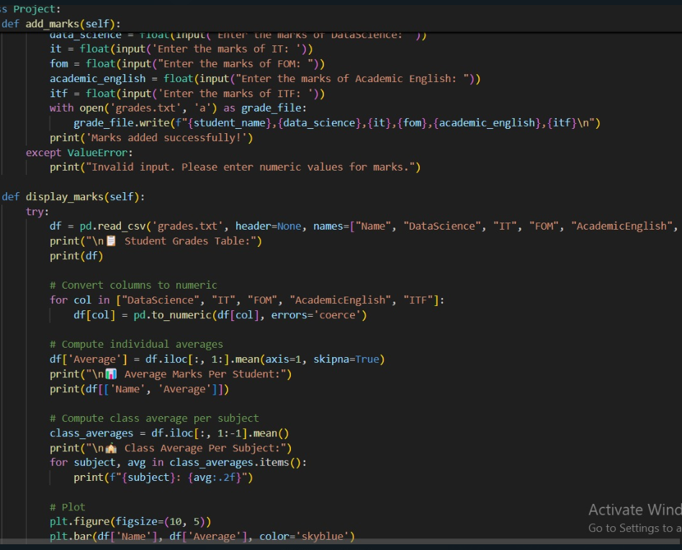

Slide 15
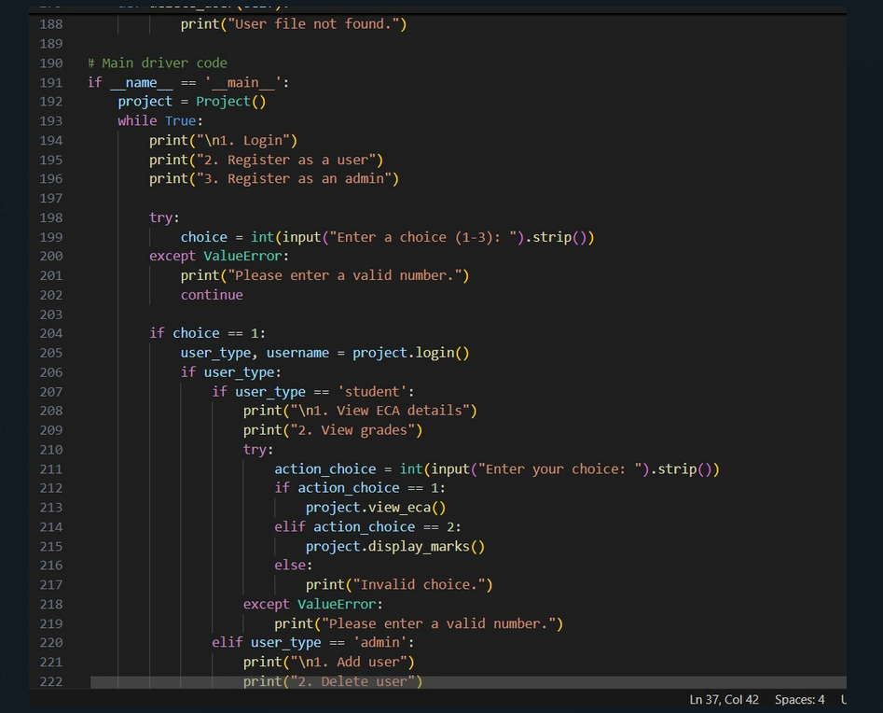

Slide 16
